Slide 1
CSCI 580 3D Graphics & Rendering
Ray Tracing Engine
Jialiu Wang
Kayla Carr
Tuo Piao
Hsiao-Lun Wang

Slide 2
Introduction
Ray Tracing is a technique for generating an image by tracing the path of light through pixels, and simulating the effects with virtual objects.
Produce very high degree of visual realism(better than typical scalene rendering methods taught in class) at a great computational cost.
Best-suited when the images can be rendered with enough time(film and TV effects); however, poorly suited where speed plays an essential role(video games).
Objective
Build a ray-tracing engine with brand new rendering functions, no external libraries or sources will be used.
SECTION TITLE | 2

Slide 3
Project Structure
GzConstants
Magic number, Mathematical constant
GzVector
Calculations of vectors
GzColor
Calculations of colors
GzMaterial
Refrac., reflec. constants, and textures
GzGeometry
Various geometries, handles intersection
GzRender
Redering process
SECTION TITLE | 2

Slide 4
Basic Shadow & Reflection
WITHOUT anti-aliasing
Anti-aliasing
SECTION TITLE | 2

Slide 5
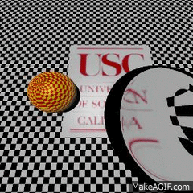
Refraction
Visual effects just like a magnifying glass.
SECTION TITLE | 2

Slide 6
Area Light & Soft Shadow
WITHOUT Area Light Feature
Area Light Feature
SECTION TITLE | 2

Slide 7
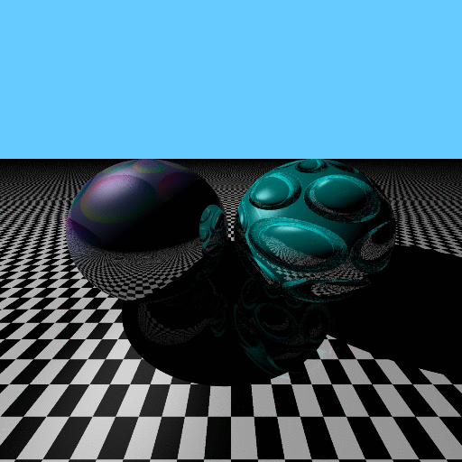
Normal Mapping
SECTION TITLE | 2

Slide 8
Conclusion
Primary objective of building a ray-tracing engine was achieved.
Algorithm such as recursive ray-tracing, Monte Carlo sampling, and normal mapping were precisely implemented so that key features were acquired.
Our engine can be applied for further developments since it is a relatively independent and complete package.
Geometry
Material
Texture
SECTION TITLE | 2

Slide 9
Reference
Arthur Appel. 1968. Some techniques for shading machine renderings of solids. In Proceedings of the April 30--May 2, 1968, spring joint computer conference (AFIPS '68 (Spring)). ACM, New York, NY, USA, 37-45.
Turner Whitted. 1979. An improved illumination model for shaded display. In Proceedings of the 6th annual conference on Computer graphics and interactive techniques (SIGGRAPH '79). ACM, New York, NY, USA, 14-.
Gregory J. Ward, Francis M. Rubinstein, and Robert D. Clear. 1988. A ray tracing solution for diffuse interreflection. SIGGRAPH Comput. Graph. 22, 4 (June 1988), 85-92.
Robert L. Cook, Thomas Porter, and Loren Carpenter. 1984. Distributed ray tracing. In Proceedings of the 11th annual conference on Computer graphics and interactive techniques (SIGGRAPH '84), Hank Christiansen (Ed.). ACM, New York, NY, USA, 137-145.
Venkat Krishnamurthy and Marc Levoy. 1996. Fitting smooth surfaces to dense polygon meshes. In Proceedings of the 23rd annual conference on Computer graphics and interactive techniques(SIGGRAPH '96). ACM, New York, NY, USA, 313-324.
SECTION TITLE | 2

